Slide 1
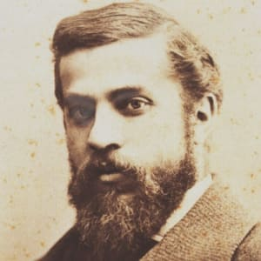
ANTONI GAUDI
ArchItect (1852–1926)

Slide 2
QUICK FACTS
NAMEAntoni Gaudí
OCCUPATIONArchitect
BIRTH DATEJune 25, 1852
DEATH DATEJune 10, 1926
EDUCATIONProvincial School of Architecture
PLACE OF BIRTHReus, Spain
PLACE OF DEATHBarcelona, Spain
AKA Antoni GaudíAntoni Gaudí iAntoni Gaudí i CornetAntoni Plàcid Gaudí Cornet
FULL NAME Antoni Plàcid Guillem Gaudí i Cornet

Slide 3
WHO IS HE?
Antoni Gaudí was a Barcelona-based Spanish architect whose free-flowing works were greatly influenced by nature.
Synopsis
The son of a coppersmith, Antoni Gaudí was born on June 25, 1852, and took to architecture at a young age. He attended school in Barcelona, the city that would become home to most of his great works. Gaudí was part of the Catalan Modernista movement, eventually transcending it with his nature-based organic style. Gaudí died on June 10, 1926, in Barcelona, Spain.
Early Years
Architect Antoni Gaudí was born in Catalonia on the Mediterranean coast of Spain on June 25, 1852. He showed an early interest in architecture, and went to study in Barcelona—Spain's most modern city at the time—circa 1870. After his studies were interrupted by military service, Gaudí graduated from the Provincial School of Architecture in 1878.

Slide 4
Development as a Professional Architect
Upon graduation, Gaudí initially worked in the artistic vein of his Victorian predecessors, but he soon developed his own style, composing his works with juxtapositions of geometric masses and animating the surfaces with patterned brick or stone, bright ceramic tiles and floral or reptilian metalwork. The salamander in Park Güell, for instance, is representative of Gaudí's work.
During his early period, at the Paris World's Fair of 1878, Gaudí displayed a showcase he had produced, which impressed one patron enough to lead to Gaudí's working on the Güell Estate and Güell Palace, among others. In 1883, Gaudí was charged with the construction of a Barcelona cathedral called Basilica i Temple Expiatori de la Sagrada Familia (Basilica and Expiatory Church of the Holy Family). The plans had been drawn up earlier, and construction had already begun, but Gaudí completely changed the design, stamping it with his own distinctive style.
Gaudí also soon experimented with various permutations of historic styles: the Episcopal Palace (1887–'93) and the Casa de los Botines (1892–'94), both Gothic, and the Casa Calvet (1898–1904), which was done in the Baroque style. Some of these commissions were the result of the 1888 World's Fair, at which Gaudí once again staged an impressive showcase.

Slide 5
The Mature Artist
After 1902, Antoni Gaudí's designs began to defy conventional stylistic classification, and he created a type of structure known as equilibrated—that is, it could stand on its own without internal bracing, external buttressing, etc. The primary functional elements of this system were columns that tilted to employ diagonal thrusts and lightweight tile vaults. Notably, Gaudí used his equilibrated system to construct two Barcelona apartment buildings: the Casa Batlló (1904–06) and the Casa Milà (1905–10), whose floors were structured like clusters of tile lily pads. Both projects are considered to be characteristic of Gaudí's style.
Final Work and Death
Increasingly pious, after 1910, Gaudí abandoned nearly all other work to focus on the Sagrada Familia, which he had begun in 1883, cloistering himself onsite and living in its workshop. While employing Gaudí's equilibrated methods, the church would borrow from the cathedral-Gothic and Art Nouveau styles but present them in a form beyond recognition.
Gaudí died while still working on the Sagrada Familia on June 10, 1926, in Barcelona, Spain. He died after getting hit by a trolley car in Barcelona, only a few weeks shy of his 74th birthday. While the structure remained unfinished at his death in 1926—only one transept with one of four towers was built—the extraordinary structure has a final completion target date of 2026, to mark the 100th anniversary of his passing.

Slide 6
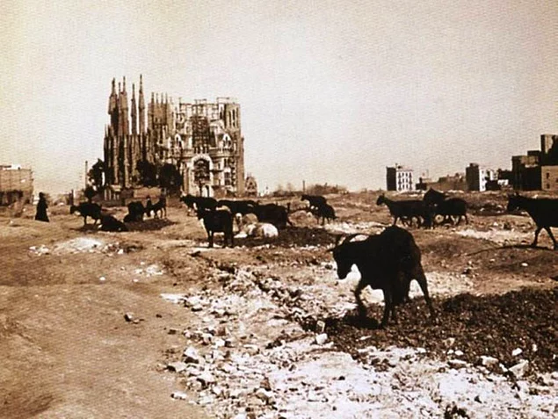
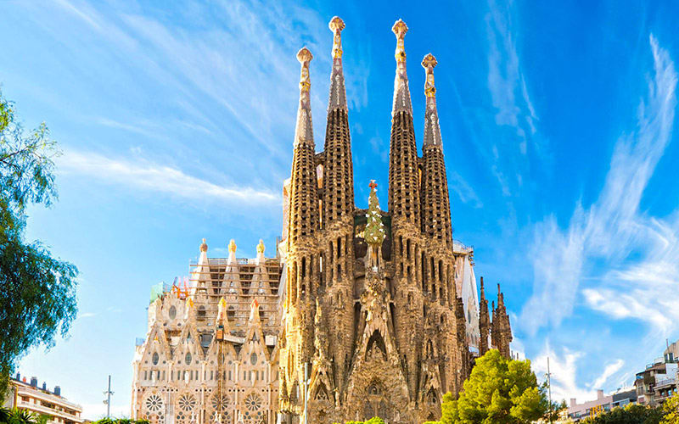
LA SAGRADA FAMALIA
La Sagrada Familia (Holy Family) is a basilica in Barcelona, ​​Spain, which was taken over in 1957 by Antoni Gaudí, who was regarded as one of the pioneers of modern architecture. The construction is still ongoing.
After Gaudi's death, the team of professionals from various disciplines is leading the completion of the Sagrada Familia project. Now the construction process, accelerated by today's technologies, is planned to end in 2026.

Slide 7
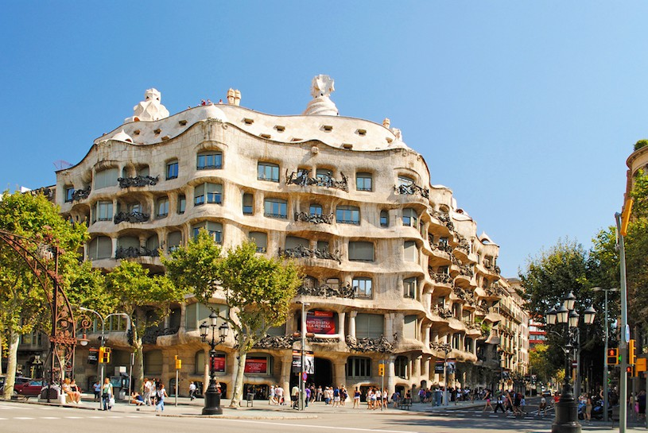
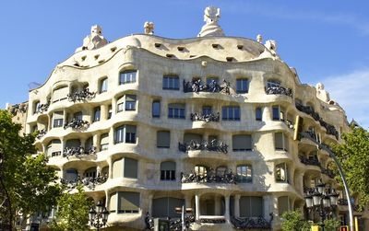
CASA MILA
Casa Mila is an apartment built between 1906 and 1910. After Sagra da Familia, Gaudi is his second most important work in Barcelona.

Slide 8
Antoni Gaudi or its full name is Antoni Plàcid Guillem Gaudi, the famous Catalan architect, who leads the Art Nouveau movement in Cornet, Spain.
Most are located in Barcelona, including his main work, the church of the Sagrada Família.

Slide 9
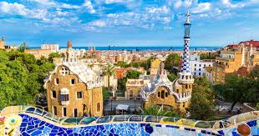
PARK GÜELL

Slide 10
Park Güell is one of the most impressive public parks in the world. The park is located in Barcelona and was designed by famous architect Antonio Gaudi.
Gaudi planned and directed the construction of the park from 1900 to 1914 for Eusebi Güell for a residential park intended for sixty single- family residences.
The project, however, was unsuccessful and the park became city property in 1923. Though never fully completed, it still remains one of Gaudi’s most colorful and playful works.
Park Güell is one of Barcelona’s most famous landmarks.

Slide 11
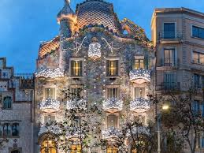
CASA BATTLO
Casa Batlló is a building located in the center of the city of Barcelona. He is one of the masterpieces of the Spanish architect Antoni Gaudí. The present design was created by re-designing the house in 1904. Gaudi himself restored the building.

Slide 12
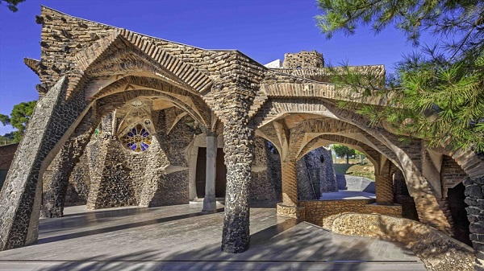
Gaudi's Crypt in Colonia Güell
The Church of Colònia Güell (Catalan: Cripta de la Colònia Güell, IPA: [ˈkɾiptə ðə ɫə kuˈɫɔniə ˈɣweʎ]) is an unfinished work by Antoni Gaudí. It was built as a place of worship for the people in a manufacturing suburb in Santa Coloma de Cervelló, near Barcelona (Catalonia, Spain). Colònia Güell was the brainchild of Count Eusebi de Güell; however, with Güell losing profits from his business, the money was depleted and only the crypt was completed.

Slide 13
REFERENCES
https://www.biography.com/people/antoni-gaud%C3%AD-40695
http://www.wikizeroo.net/index.php?q=aHR0cHM6Ly9lbi53aWtpcGVkaWEub3JnL3dpa2kvQ2h1cmNoX29mX0NvbMOybmlhX0fDvGVsbA
BERİVAN UÇAR

